Slide 1
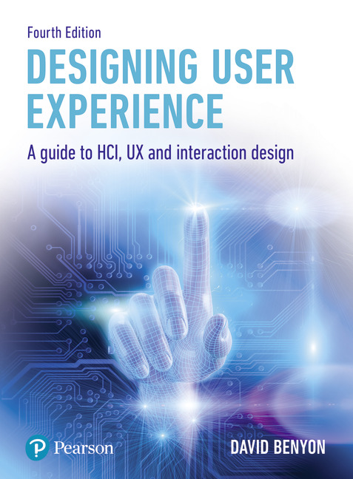
Designing User Experience
A guide to HCI, UX and Interaction Design
Fourth Edition
Chapter 9
Design

Slide 2
Contents
9.1 Introduction
9.2 UX design
9.3 Metaphors and blends in design
9.4 Conceptual design
9.5 Physical design
9.6 Designing interactions

Slide 3
Aims
As we said in Chapter 2, design is messy.
Design problems are usually poorly formed and continue to evolve as solutions are suggested.
This results in more ideas, more problems and more solutions.
In design, we distinguish conceptual design – design in the abstract – from physical design – where ideas are made concrete.
Our aim in this chapter is to provide methods and techniques to help designers deal with design situations.

Slide 4
Background
This chapter assumes that you know about techniques for understanding and envisioning ideas (Chapters 7 and 8).
It assumes that you know about scenario-based design (Chapter 3), about developing personas (Chapter 3) and PACT analysis (Chapter 2) and that the aim of design is to achieve a high degree of usability (Chapter 5) and to create engaging user experiences (Chapter 6).
Design must also consider the UX as it crosses media channels and devices (Chapter 4).
This chapter is concerned with a more abstract view of design and with thinking conceptually and metaphorically about your design.
It also provides some more formal ways of capturing and representing designs.
Details of visual design and multimodal design that will take the ideas developed in this chapter and deliver concrete design solutions are covered in Chapters 12 and 13.

Slide 5
After studying this chapter you should be able to:
Understand the nature of conceptual and physical design.
Understand how metaphor works in design.
Undertake an object–action analysis to inform design and to produce a conceptual model of a new system.
Describe how the system will look and behave through specifying the design language and interaction patterns.
Specify a design in a form that can be implemented by programmers using use cases.

Slide 6
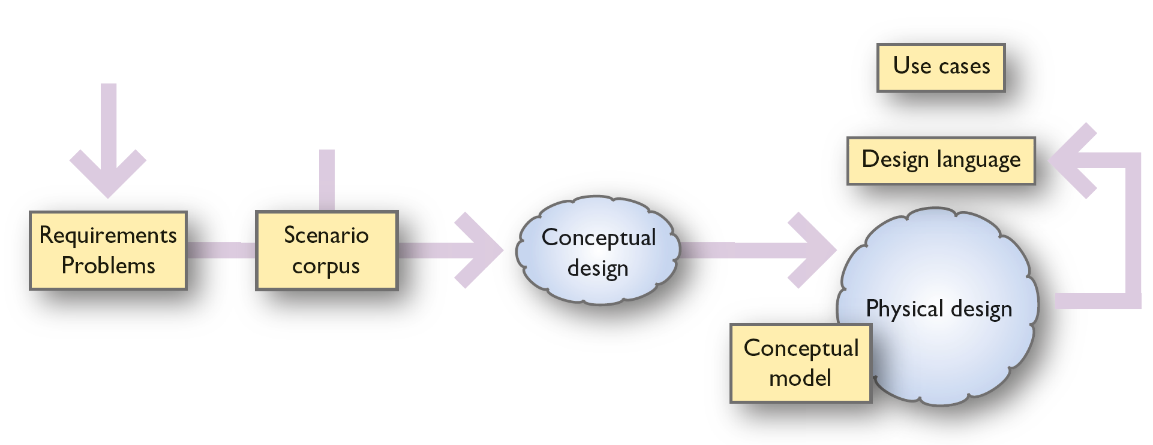
Introduction (1 of 2)
Figure 9.1 is the lower part of Figure 3.13, which we used earlier to illustrate the whole of the design process.
It shows the processes of conceptual and physical design (processes represented as clouds) and the products of design that are produced at this stage (represented as boxes).
The minimum system specification is a conceptual model, a set of use cases and a design language.
Taken alongside a statement of requirements and a scenario corpus, this constitutes a satisfactory system specification that could be implemented by a development team.
Notes:
Figure 9.1 Conceptual and physical design

Slide 7
Introduction (2 of 2)
Conceptual design is concerned with arriving at an abstract description of the system – its logic, functions, structure and content – but not with how the structure and functions are to be physically realized.
Physical design is concerned with
who does what in terms of the allocation of functions and content between people and artefacts,
what media channels will be used, how they relate to each other and what the touchpoints will be and
how the artefacts and devices will look and how they behave.

Slide 8
Conceptual and physical design
The distinction between conceptual and physical design does not dictate that conceptual design should be finished before physical design starts.
Analysts and designers will iterate between these two levels of design description and will fix on some physical design decisions in order to understand the conceptual level better.
A good deal of early physical design happens during the envisionment process.
This iteration will involve various kinds of evaluation with people so that we can check that the design really does meet their needs.
The advantage of designing at the conceptual level before details of the physical design are fixed, however, is that it avoids the problem of ‘design fixation’ and maintains a wide design space in which alternatives can be considered for as long as possible.

Slide 9
Types of design (1 of 2)
It is also important to appreciate that there are different types of design that encourage different ways of looking at problems and that will lead to different outcomes.
Critical design is an approach to design that deliberately sets out to distance itself from the current situation. It makes use of design fictions to explore new ideas and new concepts and impacts both designers, as they reflect on the designs and the reactions they provoke, and on users who have novel experiences that give them new insights into future situations (Dunne 1999).
Constructive design puts the emphasis on imaginative design. Rather than focusing on some specific requirements and a rational solution to a problem, they imagine new realities, build prototype implementations of them and evaluate to see if they work.
In the context of designing novel museum experiences, a constructive design approach highlights the development of intuitive technologies that should not interfere with the focus of the exhibition or artefact. There is a focus on the social aspects of interaction and finding ways to engage visitors, letting them choose how to interact (Petrelli, et al., 2016).

Slide 10
Types of design (2 of 2)
Green design is an approach to design that highlights ecological and sustainable solutions to design problems. It encourages designers to consider the environmental impact and the sustainability of design solutions (Friedberg and Lank, 2016).
Friedberg and Lank identify how green design delivers a bias in design and the leveraging of a particular ethos, the ability to embrace uncertainty during design, an affinity for intuition or unusual sources of data and the need to serve multiple roles simultaneously during design activities.
UX design is often about creating novel and sometimes through-provoking designs. The aim is to focus on the nature of the experience that the design aims to evoke in people.

Slide 11
UX design
Recall that UX is people acting, sensing, feeling and meaning-making in a given situation.
It includes the perceptions and sensations of using an artefact or service in a particular context.
It can include how people become aware that a potential experience exists, the anticipation of engaging in the experience, the unfolding of the experience itself and the reflection on the experience after the actual engagement is completed.
UX concerns the physical, social, psychological, emotional and ideological aspects of the experience and how these evolve over time.
UX concerns the different types of engagement with a system, product or service that different people experience as consumers, producers and sharers.
The elements of UX include its strategy, scope, structure, skeleton and surface characteristics (Garrett, 2011).

Slide 12
Good UX
Good UX comes from designers having a good conceptual model of the whole device and service ecology.
This will help deliver a good information architecture that in turn will help users to develop a clear mental model of the strategy, scope and structure.
The skeleton and surface characteristics describe the design language that users will need to understand and appreciate aesthetically.

Slide 13
Exploring the design space (1 of 2)
As we mentioned in Chapter 8, design can be thought about through the concept of a design space.
A design space constrains a design in some dimensions whilst allowing exploration of alternatives in others (Beaudouin-Lafon and Mackay, 2012).
Designers always work within constraints, whether these are financial or functional, but they need to take care not to impose too many constraints too early in the process.
Constraining the design space too soon can result in design fixation – settling on a design idea or a design constraint that prevents designers from exploring possible alternatives.

Slide 14
Exploring the design space (2 of 2)
Chapter 7 described a number of techniques and methods to help designers explore possible designs.
For example, brainstorming is a good way of expanding the design space.
Methods of envisionment described in Chapter 8 will also help designers to explore the design space.
Sketching is a method of ideation.
Chapter 4 described the importance of developing an information architecture for the whole UX that will often cross media channels.
Thus, it is important to consider all the channels and touchpoints.
We also emphasized the importance of looking at backstage structures as well as front stage functions.
During conceptual UX design, designers need to keep open to radical solutions to issues and problems and they will do this using the various methods such as service blueprints, customer journey mappings, wireframes and navigation maps.

Slide 15
Exploring UX design concepts
We have characterized UX as people acting, feeling, sensing, thinking and meaning-making through interactions with technologies in contexts.
Many of the techniques described in Section 8.3 can help UX designers explore the feelings that different designs will engender in users.
Bill Verplank (Verplank, 2007) is an interaction designer who has been sketching and designing for many years.
He develops a view designing interactions and argues that interaction design is ‘design for human use’.
He focuses on three main things, which he characterizes as:
How do you do? This concerns the acting part of UX.
How do you feel? This concerns the sensing and feeling aspects of UX.
How do you know? This concerns the thinking and meaning-making in UX.

Slide 16
How do you do?
‘How do you do’ ? is concerned with the ways in which we affect the world.
Do you poke it, manipulate it or sit on it?
For example, one distinction he highlights is between handles and buttons.
Handles are better for continuous control (e.g. a trombone) but buttons are better for discrete control (e.g. a piano keyboard).
Handles leave you in control (e.g. opening a car door) whereas buttons are more likely to trigger something automatic (e.g. opening an elevator door).

Slide 17
How do you feel?
‘How do you feel’ ? concerns how we make sense of the world and the sensory qualities that shape media.
One distinction is Marshall McLuhan’s ‘hot’ versus ‘cool’.
Marshall McLuhan wrote Understanding Media in 1964 and is famed for coining the phrases ‘global village’, ‘age of information’ and ‘the medium is the message’.
The book, which was reprinted in 1994, is a whirlwind tour through the media of his time and has much insight into how media would develop in our time.
He introduced a distinction between ‘hot media’ which are more authoritative and exact and ‘cool media’ which are fuzzy and incomplete.
Cool media invite more participation; they require the audience to fill in the gaps to interpret.
Hot media extend a single sense in high definition; they are filled with data.

Slide 18
Understanding media
Photography is a hot medium because it is high-fidelity, whereas a cartoon is a cool, low-definition medium where we fill in the gaps.
McLuhan’s book is fascinating even if difficult to read and he extends the ideas of hot and cool to all manner of concepts such as an axe (hot), the ‘city slicker’ (hot) and rural life (cool).
Focusing on ‘how do you feel’ takes us into the areas of satisfaction, affect, enjoyment, involvement and engagement.
In his introduction to the 1994 MIT Press edition of Understanding Media, Lewis Lapham characterizes McLuhan’s ideas as illustrated in Table 9.1.
Do not worry too much about understanding these dichotomies; use them as ways of thinking about ‘how do you feel’.

Slide 19
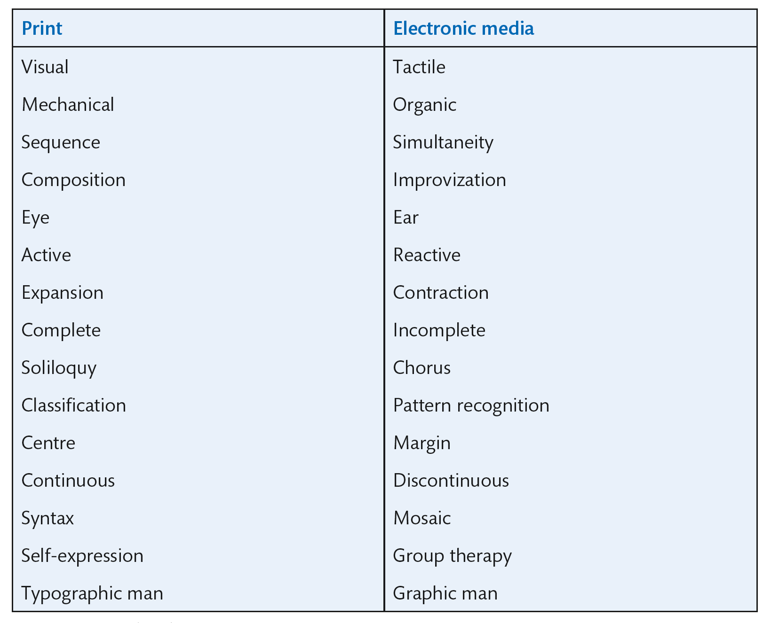
Leitmotifs from understanding media
Source: Lapham, L. (1994) in McLuhan, M., Understanding Media: The Extensions of Man, Table 1 from Introduction, © 1994 Massachusetts Institute of Technology, by permission of The MIT Press
Notes:
Table 9.1 Leitmotifs from McLuhan’s Understanding Media

Slide 20
How do you know?
‘How do you know’ ? concerns the ways that people learn and plan; how designers want people to think about their system.
For example, Verplank suggests that one choice is between maps and paths.
Paths are good for beginners as they provide step-by-step instructions on what to do.
Maps are good for understanding alternatives.
They take longer to learn but are more robust and are good for expert skill.
Maps offer the chance to take shortcuts.
Very often, of course, a given system or product will have to accommodate both.

Slide 21
Challenge 9.1
What characteristics do you feel belong to the text message as a medium? Be creative!

Slide 22
Places for experience
In the book Spaces of Interaction, Places for Experience (Benyon, 2014) Benyon lays out the different spaces that UX designers need to consider in their designs.
The physical space has a huge impact on UX and designers need to consider what opportunities or what constraints they have to work with. For example, if they are developing a mobile app to work outdoors, what connectivity issues are there. Alternatively, if they are developing a new in-store service for a retail store, what can they change in the physical space or what use can they make of physical touchpoints such as labels.
The digital space concerns all the various devices that users may bring to the device and service ecology and how this impacts the overall UX.
The information space includes digital and physical content and the software to manipulate it, including physical signage, physical objects such as tickets and receipts and embedded displays.
The social space for the UX concerns connectivity between people, how people can share experiences and how social media will be included in the UX.
Thus, the places for experience are these blended spaces that we discuss in Chapter 18.

Slide 23
Blended spaces
Blended spaces bring together physical, digital, informational and social spaces and establish new conceptual spaces where people form intentions, make meanings, have sensations and feelings and take actions.
People navigate these spaces moving through the different channels and across the device ecologies, producing and consuming information content.
Conceptual design for UX is about considering the wider issues of experiences and how any new service, product or system will fit in with existing structures.

Slide 24
Describing the UX
How UX designers describe the UX that they are looking for is a moot point.
Hassenzahl (2010) talks about having explicit experience goals.
However, our approach is to build on the idea of semantic differentials (Chapter 7).
UX designers should aim for set of descriptive adjectives (Chapter 8) that aim to capture the nature of the UX and that can be used for evaluation (Chapter 10).
Figure 9.2 shows a portion of the PowerPoint pitch that we did for the Explore Scot app, focusing on the nature of the experience we were trying to achieve which we described as engaging, authoritative and modern.

Slide 25
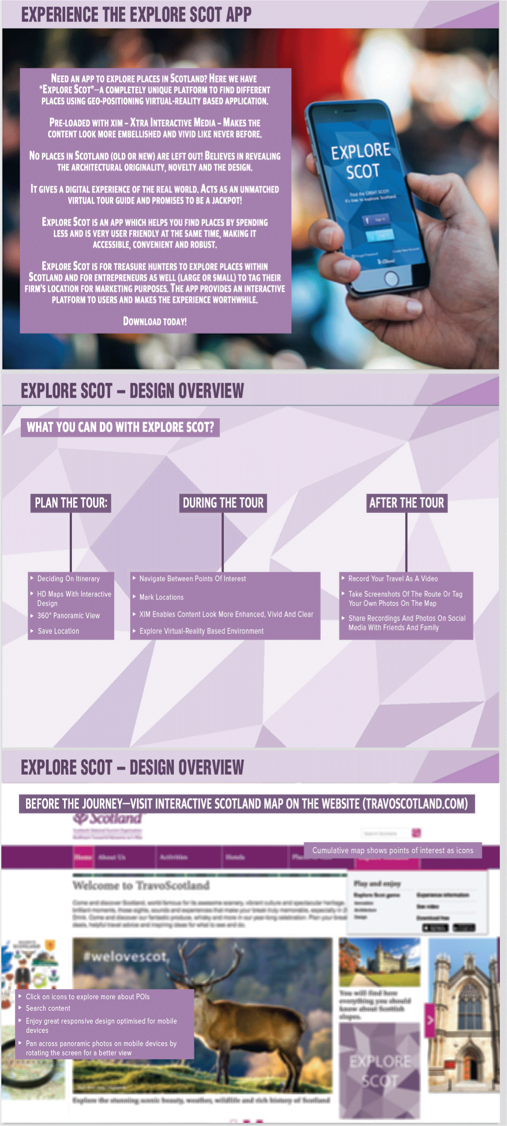
Figure 9.2
The Explore Scot app

Slide 26
Metaphors and blends in design
Metaphor is generally seen as taking concepts from one domain (called the source domain, or the vehicle) and applying them to another (the target, or tenor).
Metaphors in literature are very common but often very culturally specific.
In a ground-breaking book written in 1980, George Lakoff and Mark Johnson discuss Metaphors We Live By (Lakoff and Johnson, 1980), showing how popular metaphors such as ‘He was climbing the ladder of success’ shape the way we think about things.
Two common metaphors are ‘The ship ploughed through the waves’, and ‘The President marshalled his arguments to defend his position’.
The first of these likens a ship moving through the sea to a plough moving through a field. It suggests the waves are like the furrows.
It has connotations of strength and how the ship is pushing aside the sea. For some people, it connotes speed of movement.
In the second, we see arguments likened to a battle, arguments being marshalled as if they were soldiers, the President’s position being analogous to a castle or other physical place that needs defending.

Slide 27
Metaphors and blends in UX (1 of 3)
In the development of interactive systems, we are constantly trying to describe a new domain (a new application, a different design and new interactive facilities) to people.
So, we have to use metaphor to describe this new domain in terms of something that is more familiar.
Blackwell (2006) gives a comprehensive treatment of the role of metaphor in interactive systems design.
After a while, the metaphorical use of a term becomes entrenched in the language to such an extent that people forget it ever was a metaphor.

Slide 28
Metaphors and blends in UX (2 of 3)
Paths and maps may be thought of as metaphors for the design of interactions.
Different metaphors will lead to different conceptions and designs.
Think of the idea of navigating an interactive system, for example.
Many people immediately think that navigation is trying to get somewhere specific but this is only one view (often called ‘wayfinding’).
We also browse around and explore.
If we think of navigation as in a city, then we think of roads and signposts, metros that take us invisibly from one part of the space to another, taxis to transport us or buses that we have to learn about.

Slide 29
Metaphors and blends in UX (3 of 3)
Considering one metaphor can stimulate creative leaps into other ways of thinking.
For example, during a collaborative design meeting to look at the interface to a search mechanism, we considered the interface as a ‘Rolodex’ (Figure 9.3), a manual card index device that allowed people to rapidly flip through standard-sized cards.
A ‘gun barrel’ design emerged (illustrated in the left-hand part of Figure 9.4) alongside a more common design for search results (the right hand side of Figure 9.4).
Although the gun barrel idea was rejected, the Rolodex concept seemed to capture the idea of searching and retrieving results with an intuitive navigational style of flicking through the search result ‘cards’.

Slide 30
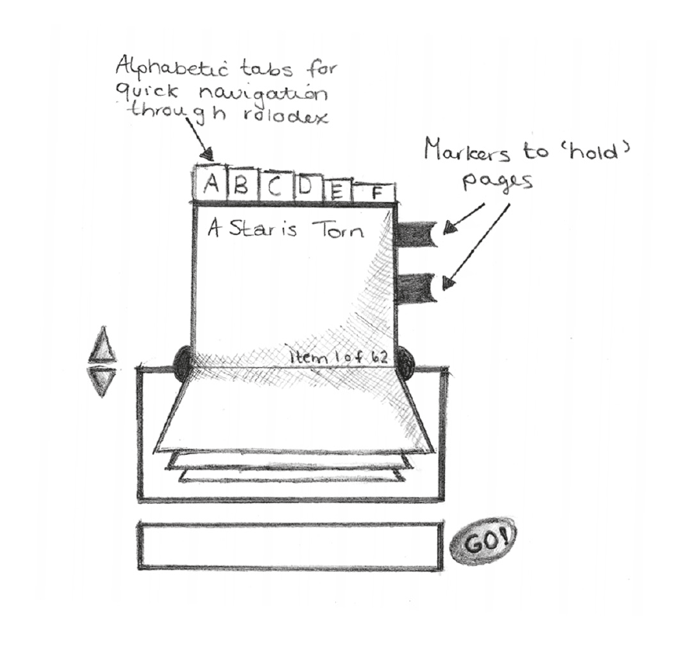
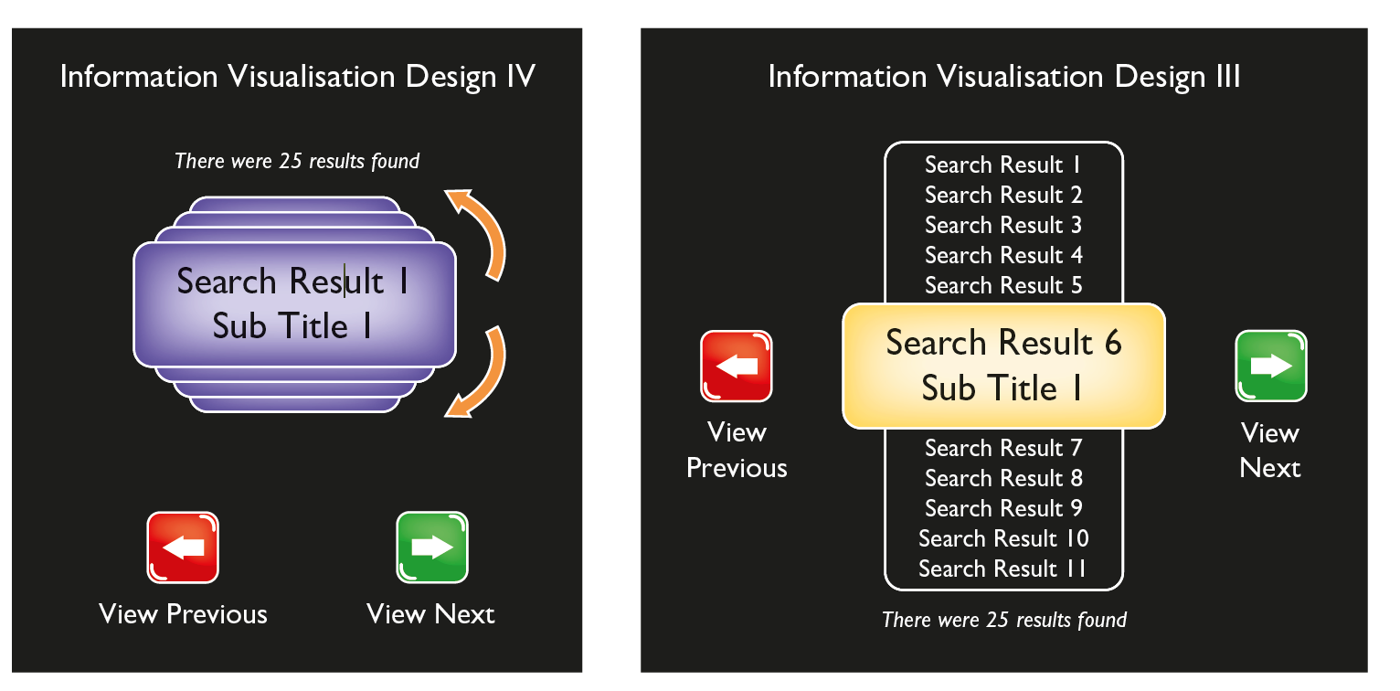
Rolodex metaphor
Rolodex is a registered trade name, but we use the term in this book to indicate the concept rather than the product
Notes:
Figure 9.3 Sketch of a Rolodex interface metaphor in a project
Figure 9.4 Snapshots of alternative designs for searching in a project

Slide 31
Navigation metaphors (1 of 3)
Metaphors that might be useful for thinking about navigation have different associations.
A wilderness, for example, is frightening, confusing and enchanting.
A desert is intimidating and beautiful but has no landmarks.
Such metaphors might encourage forging a path, enjoying the scenery and getting out.
Wilderness and desert can be included in an overall landscape metaphor where different types of terrain represent different types of information.
These metaphors encourage exploration by the user; the system provides a high-level metaphor, but users provide the more detailed structure themselves.

Slide 32
Navigation metaphors (2 of 3)
The night sky offers a different sort of space.
To the human eye, it contains objects, clusters and patterns and it is very big.
It supports the activities of mapping and identifying objects.
However, there are relatively few types of object in the night sky (galaxies, stars and planets). It is the configurations and subtypes of these objects that are of interest.
Science fiction concepts such as warp drives and worm holes can be used for quick and magic transportation to distant parts of space.
The open sea is another metaphor. It encourages a distinction between surface and depth.
Thus, it is natural to think of a lot of information as being hidden beneath the surface and only available for viewing if the user dives down.
Currents can link continents and islands and take people to unexpected places. People can look for islands of information; archipelagos provide clusters.

Slide 33
Navigation metaphors (3 of 3)
A museum has been structured to allow free roaming yet is also structured to facilitate learning.
A library is suitable for finding specific information. It is well organized and structured.
These metaphors are not meant to suggest that the interface to a particular product looks like a desert, wilderness or library (though sometimes such explicit interface metaphors can be useful); the idea here is to think about activities in different ways.

Slide 34
Challenge 9.2
Consider some of the familiar computing concepts: ‘windows’, ‘cut and paste’, ‘bootstrap’, ‘open’ a ‘folder’ and ‘close’ a ‘file’. Make a list of these metaphors. Try to write down where they came from.

Slide 35
Metaphor (1 of 2)
Metaphor is not just a literary thing, it is fundamental to the way we think.
Lakoff and Johnson (1981, 1999) and their colleagues have worked on their theories of metaphor for over 30 years. They describe a philosophy of ‘experientialism’ or ‘cognitive semantics’.
They argue that all our thinking starts from the metaphorical use of a few basic concepts, or ‘image schemas’, such as containers, links and paths.
A container has an inside and an outside and you can put things in and take things out. This is such a fundamental concept that it is the basis of the way that we conceptualize the world.
A path goes from a source to a destination.
The key to experientialism is that these basic concepts are grounded in spatial experiences.
There are other basic ‘image schemas’ such as front–back, up–down and centre–periphery from which ideas flow.

Slide 36
Metaphor (2 of 2)
An important contribution from this view is that a metaphor is much more than a simple mapping from one domain to another. It is a much more complex affair.
Take the idea of a window as it appears in a computer operating system.
We know a computer window is different from a window in a house.
It shares the idea of looking into a document, as you might look into a house, but when you open it, it does not let the fresh air in. It is only ever a window into, or onto, something.
Moreover, it has a scroll bar, which a window in a house does not. In a similar fashion, we know that the trash can, or the recycling bin, on a computer screen is not a real trash can.
The connotations of recycling files are really quite complex.

Slide 37
Blends (1 of 2)
The contribution that Fauconnier and others have made (e.g. Fauconnier and Turner, 2002) is to point out that what we call ‘metaphors’ in design are really blends.
A blend takes input from at least two spaces, the characteristics of the domain described by the source and the characteristics of the target that we are applying it to.
So, a computer window takes elements from the domain of house windows and elements of the functioning of a computer trying to get a lot of data onto a limited screen display.
The metaphor of a folder is a blend from the domain of real folders that you keep papers in and the domain of computer files which have a physical location on a disk.

Slide 38
Blends (2 of 2)
Figure 9.5 illustrates this idea of a blend.
The blend that results from bringing two domains together in this way will have some features that were not in the original domains.
Blends have an emergent structure that results from bringing two sets of concepts (from the source and target domains) together.
So, the computer window has different features from both a real window and the computer commands that preceded it.
The Rolodex concept had emergent properties. These concerned how people could navigate in the ‘virtual’ Rolodex (as opposed to a real, physical one) and how the search results were presented as opposed to how they were presented following a traditional query.
It is exactly these emergent properties that make one design better than another.

Slide 39
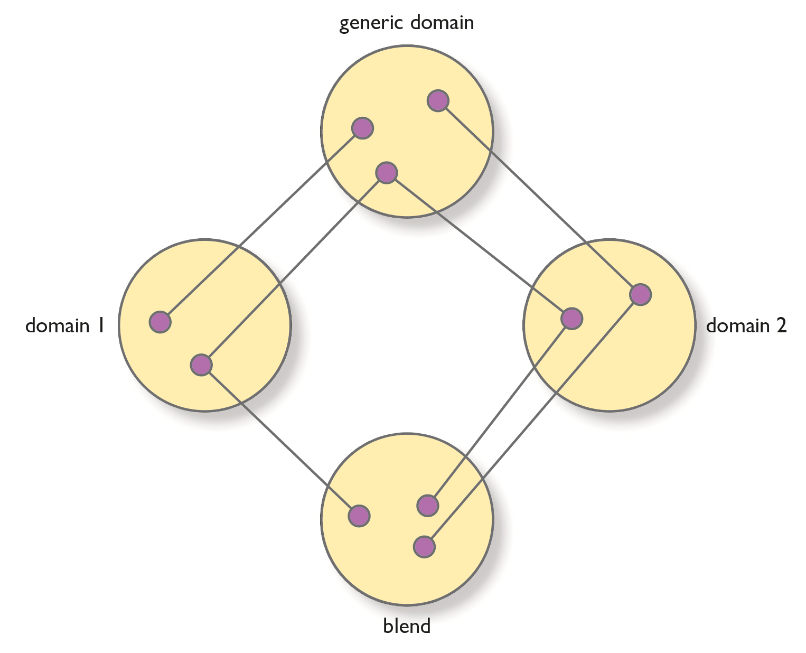
Conceptual blending
Notes:
Figure 9.5 Illustrating the concept of a blend

Slide 40
Correspondences
For metaphors and blends to work, there must be some correspondences between the domains that come from a more generic, or abstract, space.
So, for example, the metaphor ‘the ship ploughs through the waves’ works but the metaphor ‘the ship ran through the forest’ does not.
In the second of these, there is not sufficient correspondence between the concepts in the two domains.
Of course, the generic space is itself a domain and hence may itself be using metaphorical concepts.
This process works its way back until we reach the fundamental image schemas that are core to our thinking.
These include the container, path, link and others such as colours (red is hot, blue is cool, red is stop, green is go, up is good and down is bad) and those bodily schemas that come from experience and perception (up, down, in, out, central, peripheral, etc.).

Slide 41
Thinking figuratively (1 of 2)
Thinking figuratively is fundamental to both the design and use of interactive systems.
One job of the UX designer is to come up with a good metaphor that will help people in learning and using the system and in understanding the content.
Metaphor design works as follows:
The source domain has some features (concepts and functions).
The target domain has some concepts and features.
So it is important to analyse the relationship between these.
Too many features in the source domain results in ‘conceptual baggage’ of the metaphor.
Too few features, or too many inappropriate features, may lead to confusion.
Aim for people deriving appropriate expectations.

Slide 42
Thinking figuratively (2 of 2)
Note that the design of metaphors and blends does not imply a physical resemblance.
The important thing is to get a good conceptual correspondence.
Sometimes, it is appropriate to carry through a conceptual metaphor to a physical metaphor but not always.
As with any aspect of UX design, evaluation of metaphors and blends is essential. There are, however, a few principles for good metaphor design:
Integration. This is to do with coherence and not mixing metaphors. The aim here is to manipulate the whole blend, maintaining the web of relationships. The blend has its own structure and it is this that needs to have consistency maintained.
Unpacking. People should be able to unpack the blend and understand where the inputs have come from and why they work. Of course, this will often be a case of interpretation. With consideration, reflection and evaluation, the designer can achieve this. Designers should only have things in the blend for a good reason.
Topology. The different spaces should have a similar topology. We saw how the structures of waves and furrows have a similar topology, whereas waves and trees do not. Topology is about how the concepts are organized and structured.
Analysis. When undertaking an analysis, the designer should concentrate on getting the appropriate functionality and concepts, exploring the ramifications of the metaphor and evaluating how people will interpret it.
Design. At the design level, designers should consider how to represent objects and actions. They do not have to be realistic visual representations (e.g. names of menu items are often metaphorical).

Slide 43
Designing with blends
Designers cannot avoid metaphors in interaction design, so they need to consider them explicitly.
Metaphors are really blends between two or more input spaces and have their own emergent structure.
Using metaphors that exploit the fundamental domains such as bodily and perceptual schemas may help people to understand them and to form an accurate mental model.
Designers should consider principles of good blends.
Imaz and Benyon (2005) develop these ideas in their book Designing with Blends.
Bodker and Klokmose (2016) also provide an analysis of what makes a good blend, emphasizing the fact that interactions are now so cross channel that simple one-to-one blends are difficult to achieve.

Slide 44
Challenge 9.3
Think of three different metaphors (or ways of thinking about) that could be used for a diary function on a tablet.

Slide 45
Conceptual design (1 of 2)
The aim of conceptual design is to arrive at conceptual models of the domain under investigation.
Service blueprints, user journey mappings, entity models, object models and other representations are conceptual models used to explore and generate ideas as well as document them once they are designed.
The considerations in Section 9.3 and this section will help the designer to arrive at a conceptual model.
Recall that this model and how it is presented will underlie the information architecture of the system or service and help or hinder users in developing their own mental model of the system or service.

Slide 46
Conceptual design (2 of 2)
Conceptual design is also multilayered, reflecting the different levels of design described in Section 4.2.
Conceptual design concerns the strategy, scope and structure planes of Garrett’s elements of UX model.
Conceptual design concerns user needs (both removing pain and delivering gain), the objectives of the service or system, the requirements for content and functions that the service or system will have and the information architecture and interaction design.

Slide 47
Scenarios and conceptual design (1 of 3)
In Chapter 3, we illustrated how scenarios can be used throughout the design process.
Stories aid understanding and conceptual scenarios abstract from stories to provide generic activities.
Fixing certain design constraints leads to concrete scenarios that may finish up as functional specifications expressed as use cases.
A scenario corpus is developed that should be discussed and evaluated at design team sessions and with the participation of stakeholders.
There are degrees of concreteness in scenarios.
The most concrete forms are used to envision or evaluate specific interactions.

Slide 48
Scenarios and conceptual design (2 of 3)
While they are superficially easy to construct, there are a number of ways in which scenarios can be made more effective:
Complement the scenarios with some of the more visual envisioning techniques.
In a large design team, include real data and materials so that people not directly involved can appreciate concrete details.
Think hard about underlying assumptions.
Include good characterization and develop a number of personas. If this is done well, members of the team start talking about the characters – ‘If you design it like that, what will happen when the grandmother tries to use it’?
Provide a rich contextual background – this grounds design decisions in real life, forcing the designer to think about practicality and acceptability.
Team members can write their own concrete version of a conceptual scenario that reflects their particular concerns. These can be brought together and overlaps removed.

Slide 49
Scenarios and conceptual design (3 of 3)
The aim is to come up with a collection of scenarios that covers all the major uses and functionality of the service or product.
It would be impossible to write scenarios for all possible variations in use but those produced should cover the following:
Interactions that are typical of a number of similar use situations
Design issues that are particularly important for the focus of the project
Areas where requirements are unclear
Any aspects that are safety-critical.

Slide 50
Object–action analysis
A good way of doing conceptual design is to undertake an object–action analysis of the scenario corpus.
For each of the scenarios in the corpus, the analyst works through the scenario descriptions, identifying the various objects that are mentioned and the various actions that are performed.
Objects are often indicated by nouns or noun phrases and activities and actions by verbs.

Slide 51
Challenge 9.4
Look through the following paragraph from a scenario about services for the Edinburgh Festival. Ignoring common verbs such as ‘was’, ‘is’, etc. and ignoring duplicates, list the main nouns and verbs and hence the main objects and actions.
The Edinburgh Festival is a large arts festival that takes place in the city for three weeks in August. It consists of two arts festivals – the Edinburgh International Festival and the Edinburgh Festival Fringe – a book festival, a film festival, a jazz festival and a variety of related events. The International Festival is the original, and up until the mid-1980s was the bigger of the two. This is the official festival, which features prestigious performers from around the world, world-class orchestras, composers, ballet troupes, etc. The Fringe, on the other hand, started as an unofficial adjunct to the festival, traditionally more informal and adventurous. It featured new theatres like the Traverse, or the work of artistic mavericks like Demarco. Gradually over the years, it has become larger than the official International Festival. In total, the Edinburgh Festival consists of some 1200 distinct events that take place at 150 different venues spread throughout the city.

Slide 52
Scenario corpus
Working with a corpus of scenarios in this way requires four stages:
Analyse the individual scenarios, distinguishing between specific actions and more general, higher-level activities.
Summarize objects and actions from each scenario, merging similar or identical actions where necessary.
Bring together the analyses from the individual scenarios, collating them into summarized objects, actions and more generic activities.
Merge actions and objects where they are identical and give them a single name.

Slide 53
Objects and actions in a music player example
Scenario:
P1. Anne is a freelance arts journalist who works mainly from home. She’s writing a piece for a national newspaper about singer-songwriters and is irritated to find she can’t remember the lyrics of a particular well-known song she wants to quote in her article. She knows the name of the singer and the song title, but beyond that, her memory is failing her.
P2. She leaves her desk, hoping a break and a cup of coffee will dispel the block. While in the kitchen, she realizes that the music player can help her out. She remembers she has downloaded the song she needs at some time in the past two months or so and knows it’s still in the music player’s storage area.
P3. She selects the ‘play’ function to where she can see ‘music search’. She selects this and the interface comes up, asking her to enter some search details. She can search by entering an artist name, track title or music genre – these are all elements of the music’s metadata which the player can recognize. She is about to enter the artist’s name but realizes she has stored several of this singer’s tracks, so she enters the track name instead.
P4. The player quickly finds the track and asks her if she wants to play it now. She does and selects this option by touching the screen. The music player controller appears on the screen, with the selected track already loaded and ready to play.

Slide 54
Analysis (1 of 2)
In the analysis, activities are shown in the far left column referencing the paragraph number. Where these appeared to be made up of a sequence of individual sub-activities, these are identified in column 2.
Actions and objects derived from these appear in columns 3 and 4.
Comments are included in column 5.
Note that this is only a fraction of the analysis of the music player scenario analysis used here to illustrate the idea.
A tally of the number of occurrences of each action (column 1) and object (column 2) is kept.
Various notations are used to indicate questions, slightly different views or uses of the terms and so on.
The aim of this analysis is to understand the objects and actions in a domain.
It is vital to note that there is no definitive or ‘right’ answer here.
The object–action analysis is just another way of exploring the design space.

Slide 55
Analysis (2 of 2)
Actions that could be thought of as generically similar can now be grouped together, prior to the final distillation stage.
This requires careful attention to avoid mistakenly merging together slightly different actions.
The guiding principle is to look for conceptual or functional parallels amongst the actions, indicating likely candidates for grouping.
The table is annotated with comments, documenting the criteria applied in making the groupings.
Here, each grouping of actions is merged and given a single name.
In each case, this is the generic term that will be used from this point on.
Table 9.4 illustrates this process with the actions of ‘select’ and ‘choose’.

Slide 56
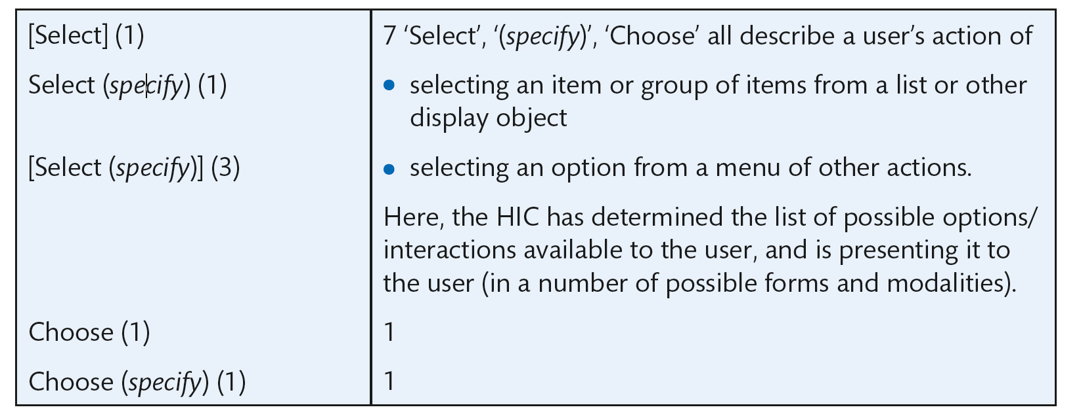
Object/action analysis
Notes:
Table 9.4 Considering the various uses of actions select and choose

Slide 57
Object–action analysis of part of scenario MP3/01
So, the object–action analysis has resulted in a generic action of select and an understanding of the various objects that can be selected: Track, Playlist, Playlist Catalogue and Query result.
The result of the object analysis could be represented as an object model or entity–relationship model as illustrated in Figure 9.6.
This may be read as a Playlist Catalogue consisting of many Playlists, though each Playlist is on just one Playlist Catalogue.
A Playlist consists of many tracks.
Each track is on just one Playlist and one Tracklist.
A Track may be the result of a Query.
Notice how, by developing a conceptual model, we are able to raise and discuss design issues.
You may disagree with some of the assertions above. This is fine. This is exactly why making the conceptual model explicit is useful.

Slide 58
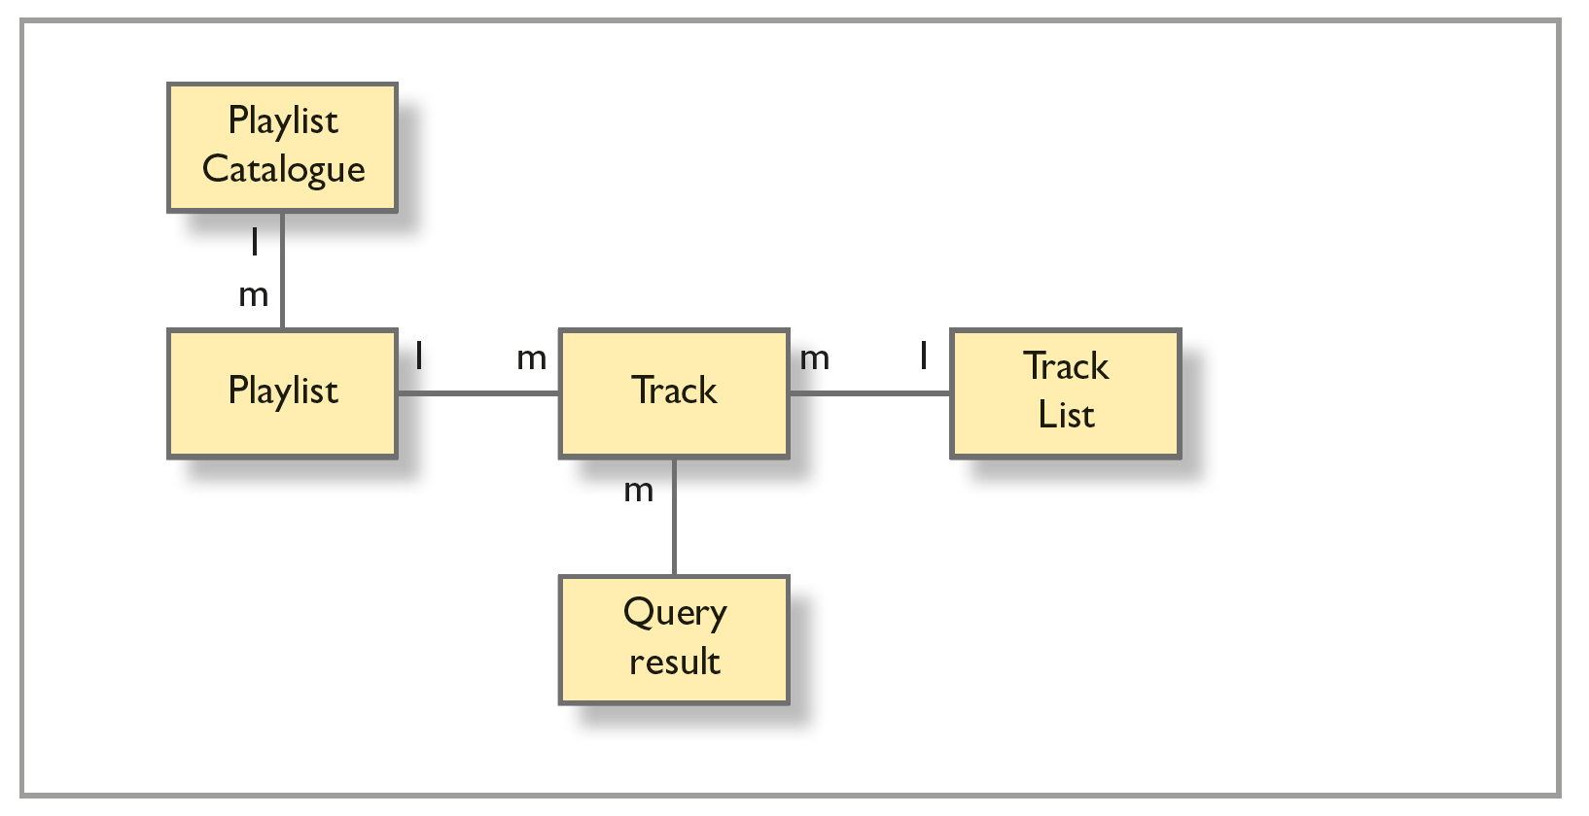
Conceptual model
Notes:
Figure 9.6 Possible conceptual model for MP3 example

Slide 59
Conceptual model (1 of 4)
Designers will often represent the conceptual model of a system using a diagrammatic technique such as an entity–relationship model or object model.
Object models, or entity–relationship models, represent the main objects of interest in a domain and the relationships between them.
There are many books devoted to such conceptual models and the techniques can be used to explore the conceptual structure not simply to document it.
There is an important distinction in conceptual models between the specific instances of an object and the class or type of object.
In the MP3 example, an instance of the object type ‘Track’ might be ‘Moondance’ and another instance might be ‘Gloria’ (both songs by Van Morrison as it happens).
What makes us group these things together as an object type called Track is that they have certain characteristics in common such as a track name, a duration and so on (classification is discussed briefly in Chapter 7, also see discussion in Chapter 3).
Relationships between objects are expressed in terms of how many instances of an object can be related to how many instances of another object.
Typically, we are not interested in exactly how many instances but rather whether a relationship exists between one or many instances.
The conceptual model is annotated with a 1 if an instance can be related to only one other instance or an m if it can be related to many.

Slide 60
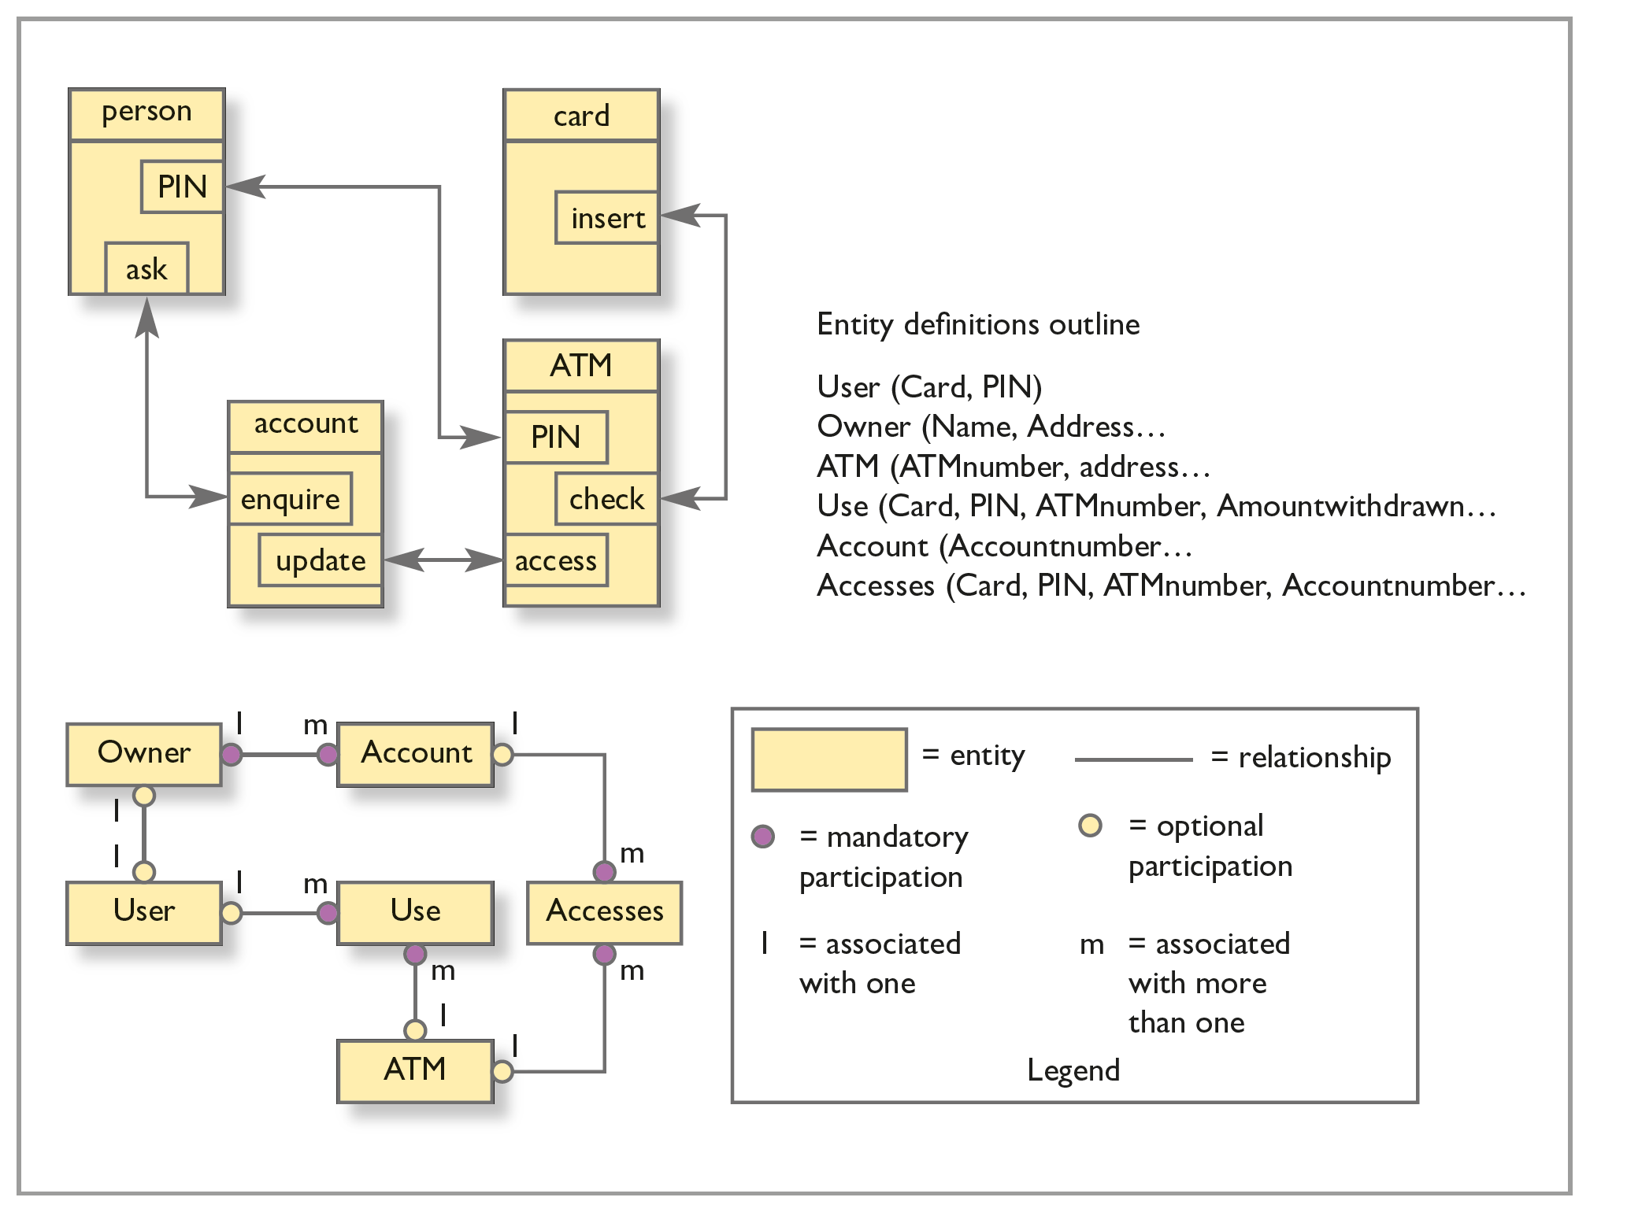
Figure 9.7
Two conceptual models of an ATM: object model above and entity–relationship below

Slide 61
Conceptual model (2 of 4)
Figure 9.7 shows two alternative conceptual models of the same thing, an ATM.
In the upper part is an object model that shows the relationships amongst the concepts person, card, account and ATM.
A person may ask about an account, the card is inserted into the ATM and so on. In the lower part is an entity–relationship model.
This is more complex but captures more of the semantics of the situation.
The model distinguishes between the concept of a user and the owner of the card. It distinguishes a usage of the ATM and the accounts that may be accessed.

Slide 62
Conceptual model (3 of 4)
Such diagrams rarely exist without some further explanation, and entity–relationship diagrams in particular can become quite formalized.
For example, the entity–relationship diagram in Figure 9.7 includes a notation showing the participation conditions (optional or mandatory) of entities in relationships and some outline definitions of the entities in terms of the attributes that they contain.
Attributes can be shown on the diagram as ovals if required.
It is not the intention to explore all the details of conceptual modelling techniques here but rather to make designers aware that they exist.
Books are available on object modelling (e.g. van Harmelen, 2001) and on entity–relationship modelling for interface design (Benyon et al., 1999).
Some approaches to information architecture also include formal models.
The point to note is that such techniques can be very useful in externalizing the conceptual structure that underlies a design.

Slide 63
Conceptual model (4 of 4)
In website design, it is usual to produce a ‘site map’ – a conceptual model of the site’s structure.
Conceptual modelling using a formalism such as an object model can be a very powerful tool in helping the designer to think about the details of a design.
By externalizing the objects and relationships in a system, the designer can see more clearly whether the logic of a design works.
Information architecture is discussed in Chapter 4.

Slide 64
Elements of interaction
Dan Saffer (2009) suggests that there are six key elements of interaction design that need to be considered. In many ways, these are similar to the notion of interaction trajectories discussed in Chapter 6. His elements are as follows:
Motion – objects that don’t move and don’t interact. Motion as a trigger for action. Behaviour as motion coloured by attitude, culture, personality and context
Space – movement happens in space and interaction design involves a combination of physical and digital space
Time – movement through space takes time and all interactions take place over time. Time creates rhythm
Appearance – proportion, structure, size, shape, weight and colour
Texture – variables such as vibration, rough, smooth and so on
Sound – pitch, volume and timbre.

Slide 65
Physical design
Even though we think of the skeleton and surface planes of the elements of UX as physical design, there is still a conceptual design element to these and the representations we discuss in this section, design languages and design patterns, are still quite abstract.
For example, decisions about the colour palette and visual style will need to reflect the strategy and scope of the system or service.
Decisions about interfaces, navigation and how content is presented will also need to be consistent and to embody the feelings and meanings that the service or system is trying to engender in the users.
Physical design is concerned with how things are going to work and with detailing the look and feel of the product. Physical design is about structuring interactions into logical sequences and about clarifying and presenting the allocation of functions and knowledge amongst people, channels and devices.

Slide 66
Three components to physical design
Operational design is concerned with specifying how everything works and how content is structured and stored.
Representational design is concerned with fixing on colours, shapes, sizes and information layout. It is concerned with style and aesthetics.
Interaction design in this context is concerned with the allocation of functions to humans or to technology and with the structuring and sequencing of the interactions.
Much of the detail of physical design is covered in the chapter on the visual aspects of interface design (Chapter 12) and multimodal design (Chapter 13).
In this section, we consider two key design ideas that help designers deal with operational design and interaction design: design languages and interaction patterns.

Slide 67
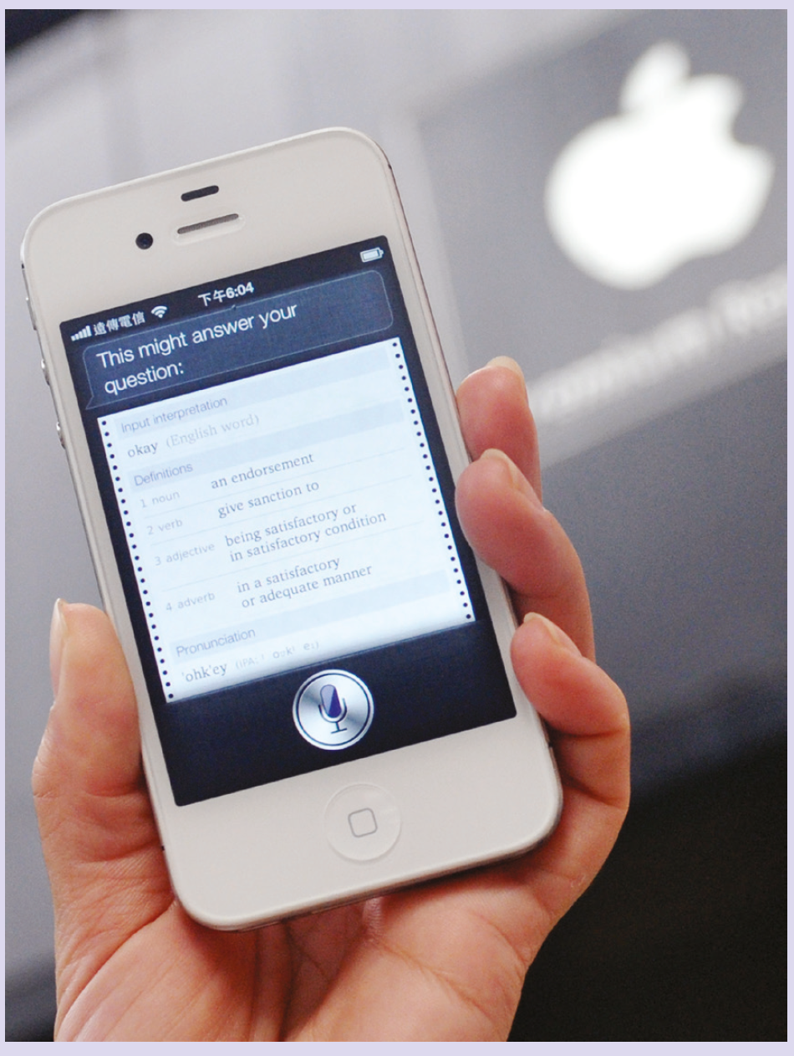
Skeumorphic design
Skeuomorphic design is designing something to physically resemble something from the past.
This may work quite well if it helps people transfer the functionality from a familiar object to a new one and a skeuomorphic design may utilize an explicit visual metaphor in order to build on a conceptual metaphor.
But often the use of a skeuomorphic design seems gratuitous, unnecessary and an out-of-date aesthetic.
Apple have come in for a lot of criticism in the OSX operating systems for making the place holder for electronic magazines look like an old-fashioned wooden bookshelf and for making the calendar look like an old leather calendar.
Source: Mandy Cheng/AFP/Getty Images
Notes:
Figure 9.8 Voice recorder from Apple

Slide 68
Design languages (1 of 3)
A design language consists of the following:
A set of design elements such as the use of colour, styles and types of buttons, sliders and other widgets
Some principles of composition (i.e. the rules for putting them together)
Collections of qualifying situations – contexts and how they affect the rules.
A consistent design language means that people need only to learn a limited number of design elements and then they can cope with a large variety of different situations.
A design language is how designers build meaning into objects, enabling people to understand what things do and to make distinctions amongst different types of object.

Slide 69
Design languages (2 of 3)
Any language provides a way of expressing things and design languages are ways of expressing design concepts.
Languages are useful for particular purposes if they have appropriate elements and appropriate organizing principles and use an appropriate medium for both expression and transmission.
Rheinfrank and Evenson (1996) stress that design languages have most impact when they have become deeply embedded and when people use them and exploit them unconsciously. Their method for design includes developing a design language through the following:
Characterization – the process of describing existing assumptions and any pre-existing design languages
Re-registration – the creation of a new assumption set through exploring trends and needs through field research
Development and demonstration – using storyboards, prototypes and other envisioning techniques
Evaluation of the reactions to the design
Evolution of the language over time. No matter how good a design, it will only last so long – until circumstances force it to be revisited.

Slide 70
Microsoft’s design language
Starting with the Windows 7 mobile platform and moving onto the desktop in Windows 8, Microsoft introduced a new design language for their products.
Originally called ‘Metro’, the inspiration for the language is described on their website as being Swiss influenced print and packaging and railway signage with the focus on motion and content over chrome.
The language has evolved further in Windows 8 and Windows 10.
The main features of the design language were as follows:
Motion. A system is created to bring the interface to life by developing a consistent set of motions or animations which provide context for usability.
Typography. Aiming for the right balance of weight and positioning can help lead users to more content.
Content not Chrome. Extra chrome is removed so that in the UI, the main focus becomes the content.
Honesty. Design specifically for a hand-held device, incorporating a high resolution screen and using touch. Interaction is expedited and made simple.

Slide 71
Design languages (3 of 3)
Design languages help ensure transparency, helping people to understand what is going on inside a device.
They also afford transferability of knowledge from one device to another.
The user of one Android phone can generally expect to find similar design on another Android phone.
This also means that people will more readily see opportunities to use a device or function and will expect certain behaviours, structures or functions.
Finally, people will identify with a style, which helps define their identity; they act through the design language.

Slide 72
Design language for the music player (1 of 2)
The music player app described earlier was envisaged as working on a touchscreen environment where serious functional constraints were imposed by the size and proximity of text in the display.
Selecting by simple touch was probably the most intuitive solution. However, all but the smallest fingers would find it hard to pick a track unambiguously unless the text was large and widely spaced.
One possible solution that was proposed is shown in Figure 9.10.
People can drag the track into the white slot in the module (A) to select it.
In this instance, the interaction can take two possible courses: people either drag the track into the slot and take their finger away, resulting in the track being loaded, or they can abort the selection, in which case the track returns automatically to its position in the Rolodex.
This ‘recoverability factor’ is one of the basic design principles.

Slide 73
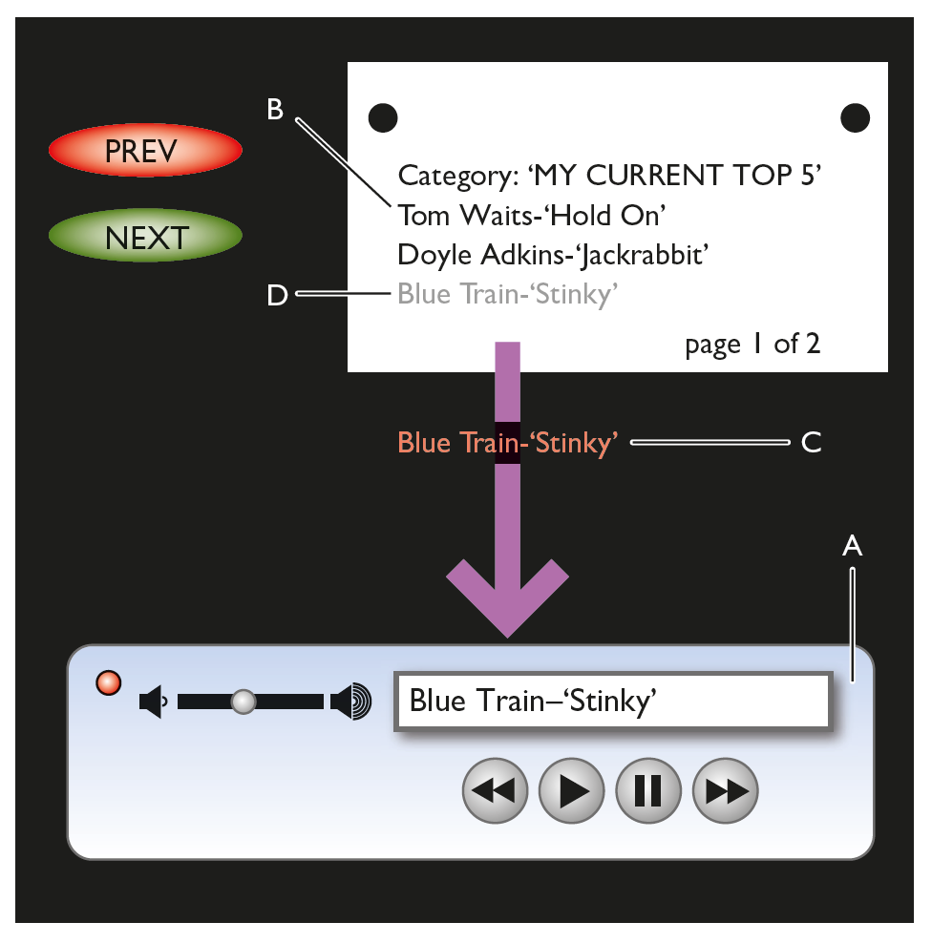
Design language for the music player (2 of 2)
Whether the interaction is completed or aborted, the text item changes colour from black (B) to orange (C) while it is in transit, to indicate it is ‘active’.
A dimmed version of the track name (D) remains in the Rolodex while the track is being dragged.
Thus, the proposed language elements are dimming of selected items, dragging to select, changing the colour to indicate selection and so on.
Notes:
Figure 9.10 Possible design for selection action

Slide 74
Designing interactions (1 of 3)
The design of interactions is critical to UX design.
The conceptual design should be as independent of an implementation as possible.
The move from conceptual to physical design requires designers to allocate functions and knowledge to persons or to devices and hence to create interactions.
For example, in the case of the music player, there have to be actions that select tracks and that play tracks, that modify playlists or that load playlists.
But this does not say who does what.
For example, the selection of a track can be left to a random function of the music player.
Playlists may be bought from a content provider or created by the system based on statistics such as how often they are played.

Slide 75
Designing interactions (2 of 3)
In designing interactions – that is allocating functions to people or to devices – designers need to consider the capabilities of people and the constraints on what they can do.
People will forget things over time.
They will forget things in working memory in a very short time.
They are not good at following long lists of instructions, at carrying out boring tasks repeatedly and so on.
On the other hand, people are good at improvising and at dealing with ambiguity and incomplete information.
On the whole, the capabilities of technology are just the reverse.

Slide 76
Designing interactions (3 of 3)
But it is not just a question of efficiency.
The interaction should be engaging, enjoyable and fulfilling.
Moreover, if the system supports working life, it should help create satisfying and meaningful jobs, while a product for home use has to fit lifestyle and desired image.
Of course, in a very real sense, this whole book is about designing interactions, so understanding, evaluation and envisioning design ideas are critical.
In this section, we aim to provide more formal methods to help in this process.
The first of these is interaction patterns and the second reviews a number of models for structuring interactions.

Slide 77
Interaction patterns
Ideas of patterns – perceived regularities in an environment is common
Architectural patterns developed by Christopher Alexander A Timeless way of Building
Patterns are at different levels of abstraction.
For example, double click, right click and so on
Common on things like audio-visual players
More recently, there are patterns for gestures, interactions with multi-touch displays, etc.

Slide 78
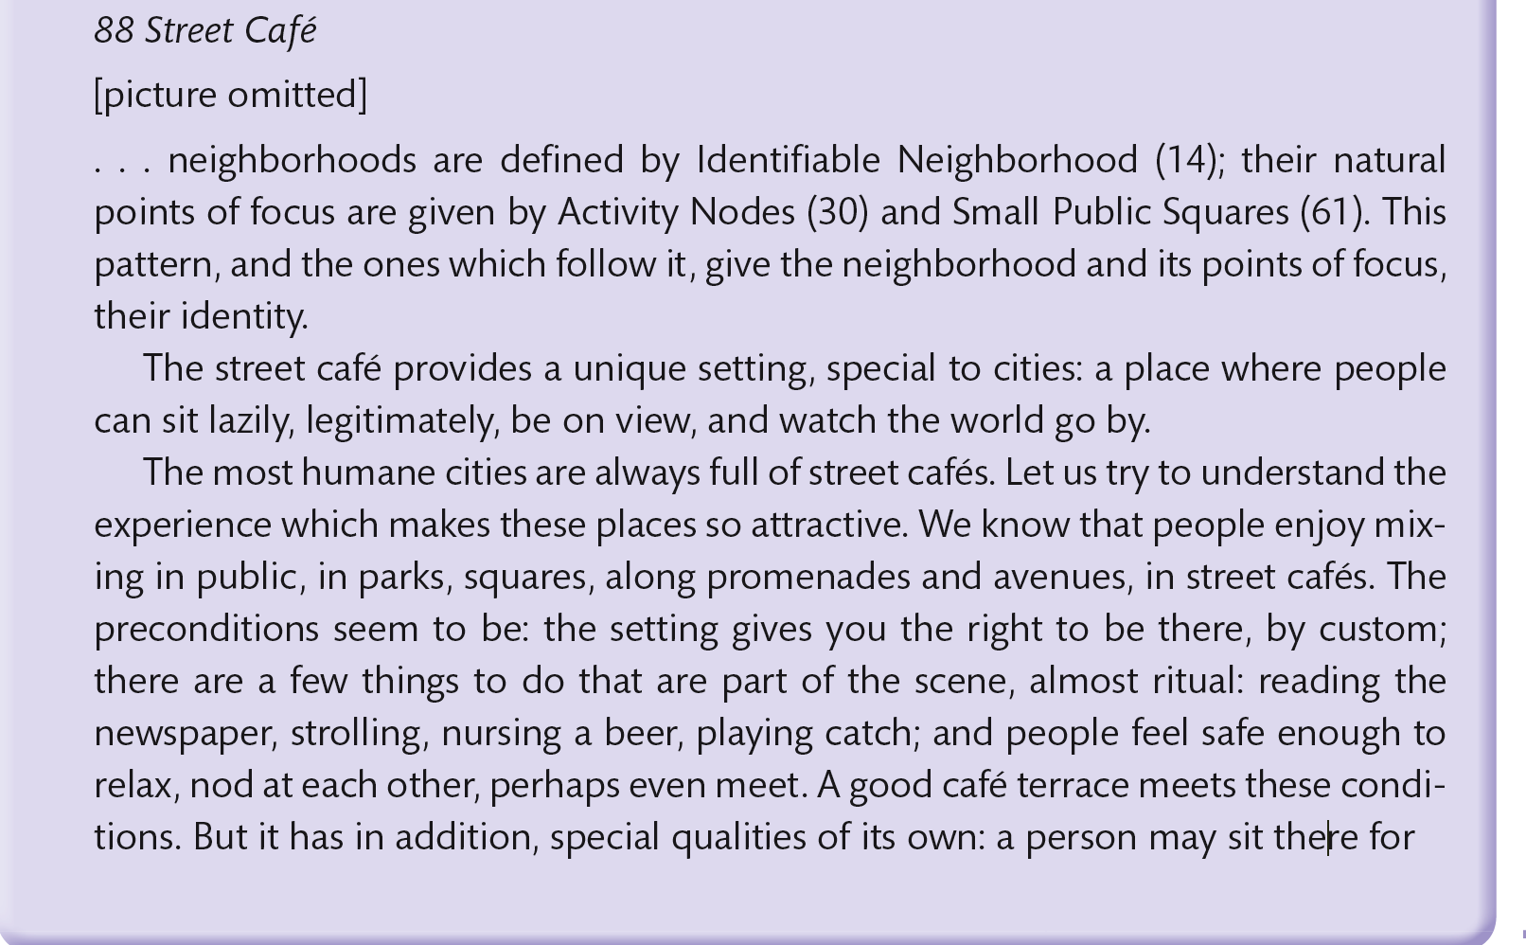
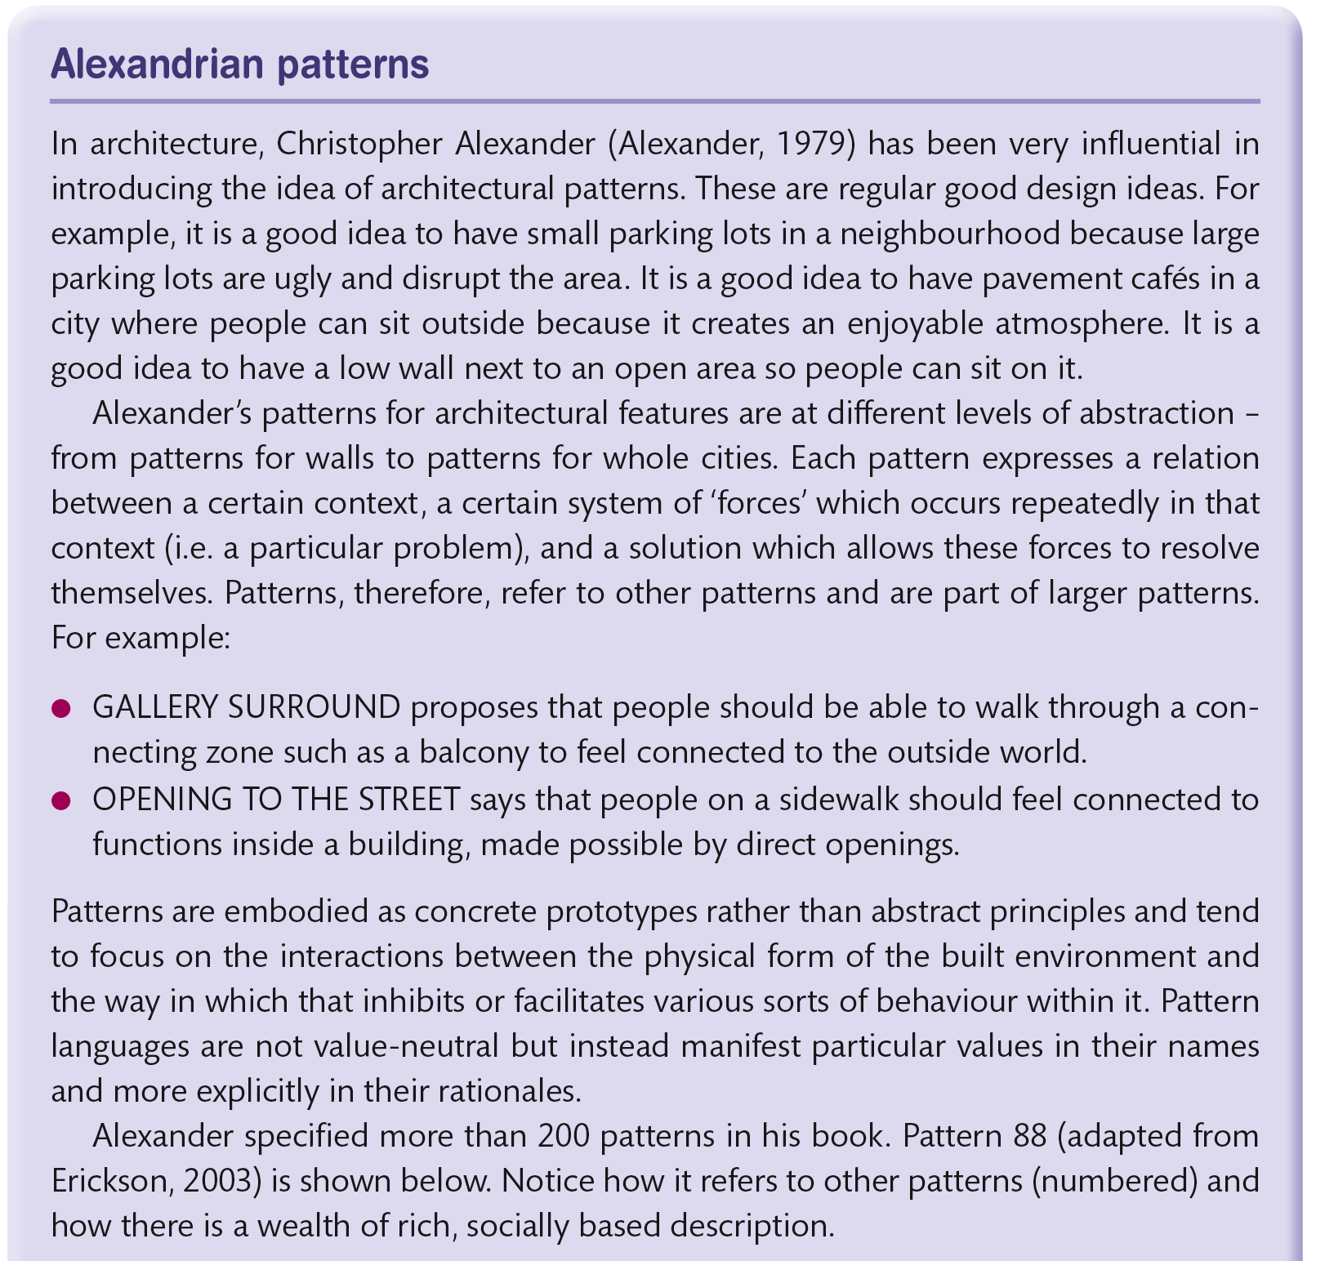
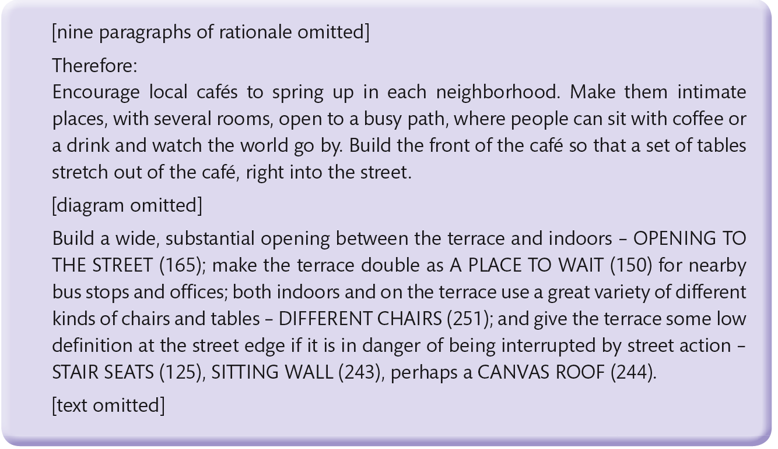
Box 9.5

Slide 79
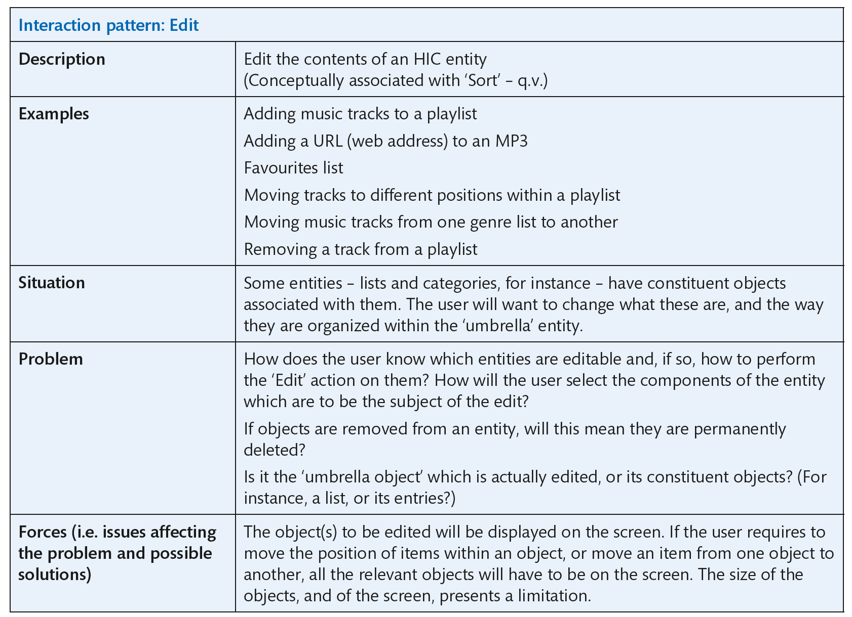
Notes:
Table 9.5 An interaction pattern for the Edit action

Slide 80
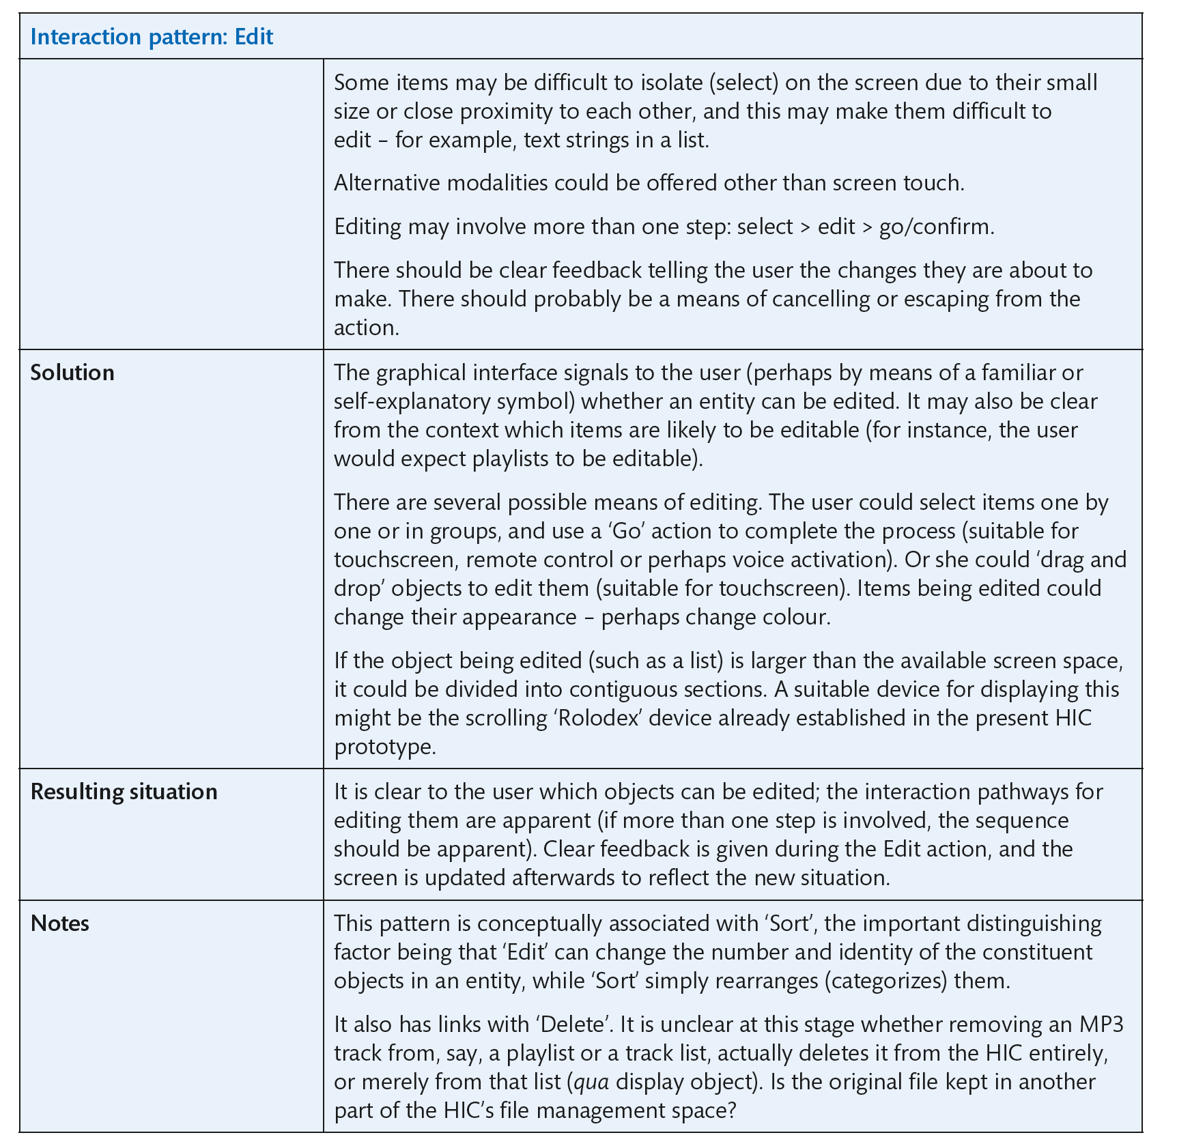
Notes:
Table 9.5 An interaction pattern for the Edit action (Continued)

Slide 81
Challenge 9.5
Look at the interaction patterns on a mobile phone that you have available.
What combination of buttons and displays does what?
Identify the ‘select’ key or select pattern.
Identify the ‘move down’ pattern.
Does it always work in the same way or are there different patterns for ‘move down a menu’ and ‘move down through some text’?
Compare the existence of patterns in phone design to those in the design of car controls.

Slide 82
Diagrammatic techniques
Designers will often represent the conceptual model of a system using a diagrammatic technique such as an entity–relationship model or object model. Object models, or entity–relationship models, represent the main objects of interest in a domain
and the relationships between them. There are many books devoted to such conceptual models and the techniques can be used to explore the conceptual structure, not simply to document it.

Slide 83
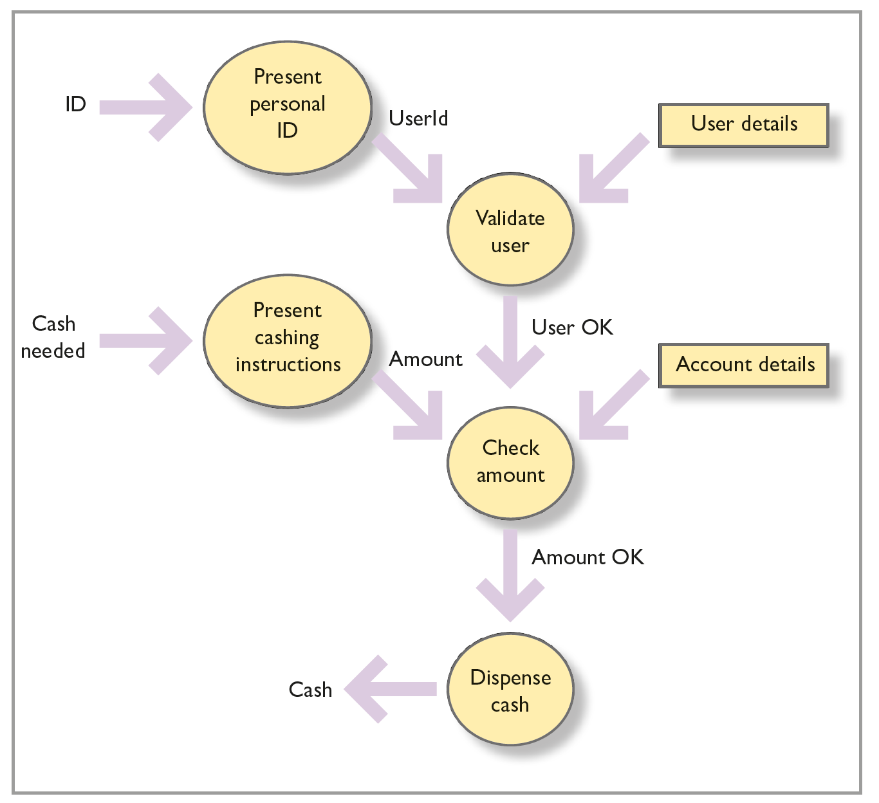
Dataflow
Notes:
Figure 9.11 Dataflow diagram

Slide 84
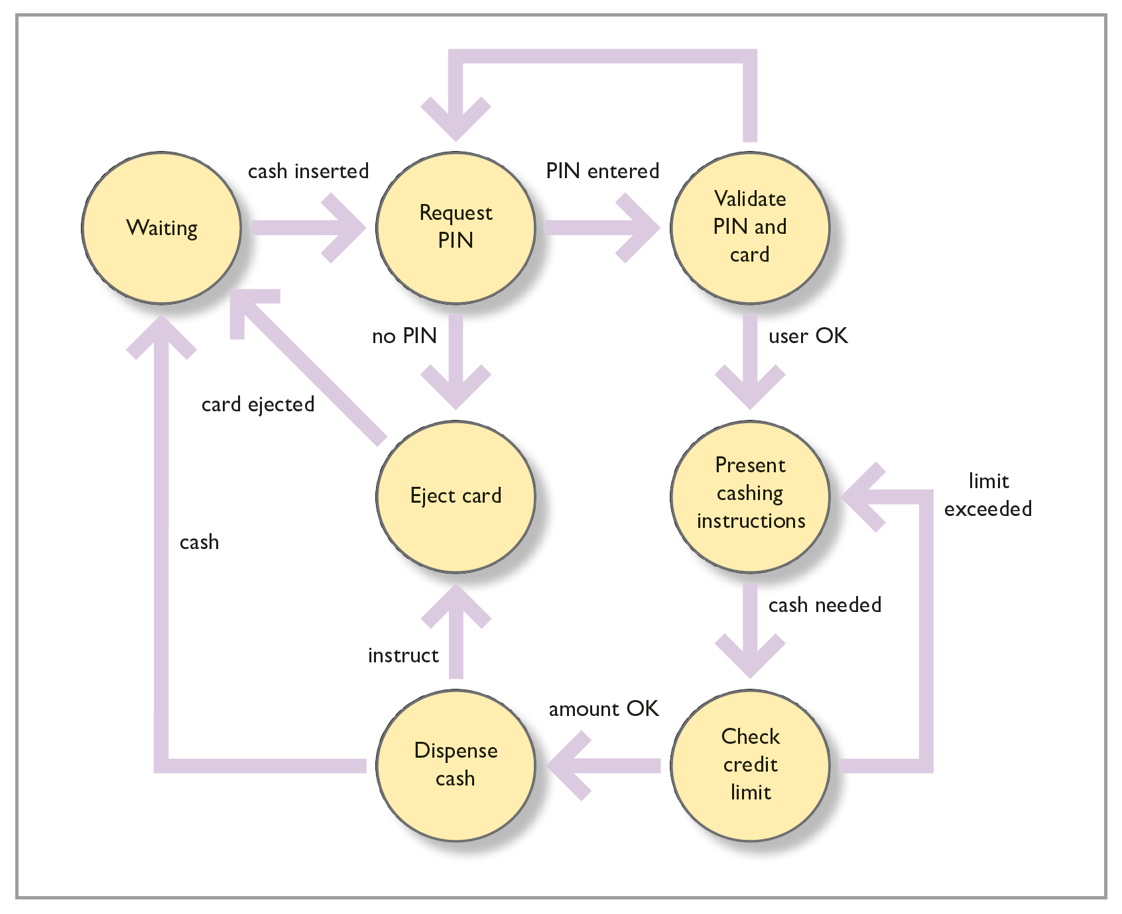
State transition network
Notes:
Figure 9.12 State transition network for ATM example

Slide 85
Summary and key points
Designers need to explore the concepts and blends in their designs.
Designers can understand objects and actions in the existing and proposed system by analysing the scenario corpus.
Designing interactions is concerned with allocating functions to people or devices and hence arriving at a set of interaction patterns.
Designers should ensure that there is a consistent design language in terms of both the patterns of interaction and representational aspects of design.

